Slide 1
Standley Lake Cross Country
Team & Parent Meeting

Slide 2
Coaches
Annie Martines
Girl’s Head Coach
Annie.Martines@jeffcoschools.us
Daniel Amram
Boy’s Head Coach
amramd95@gmail.com
Conley Marquez
Girl’s Assistant Coach
conleymarquez1@gmail.com

Slide 3
What is Cross Country?
General
Cross Country is both a team and individual sport
Athletes run a 5K (3.1M) race
Races are run on various courses
Scoring:
At the conclusion of the race, the places of the first 5 runners on each team are tallied and lowest score wins. The 6 and 7 runners are called “displacers” and can still affect team scoring if they can finish ahead of other teams’ first five runners.
Everyone competes at every race*

Slide 4
Practice Schedule
Start of Practice –
Aug 12th - Mid-October*
Monday - Friday
3:45PM – 5:45PM*
Still in school so dress code still applies.
Inclement Weather (lightning) - Will be inside, upper and lower hallways.
Practice will be held over Fall Break and is mandatory unless you’ll be out of town.

Slide 5
Expectations at Practice
What to bring: water, athletic clothing, and running shoes
Complete entire training day
WE RUN!
Run the routes instructed to you at the beginning of practice
Run with a buddy at all times!
Keep ears alert (no headphones/music during practice)
Take care of yourself (academics, hydration, nutrition, sleep)

Slide 6
Expectations at Practice
Complete before August 12
Physical
Advanced Urgent Care offers physicals for $35
Successful registration and payment of athletic fee
Please contact Courtney.Baughman@jeffco.k12.co.us with any questions
Signed last page of the athlete/parent expectations packet
Runnings shoes
Racing flats (not required but strongly recommended for competitive athletes)
Water bottle

Slide 7
Team Store/Shoe Night
Spirit Pack -
Will be posted on website
Must buy uniform shorts, warm up top, warm up bottoms (player pack)
Shoe Night - Road Runners (Walnut Creek)
August 20 from 6PM-8PM
Purchase running shoes and racing flats at a discounted price

Slide 8
Attendance
2 UNEXCUSED absences of the season = must sit out the next meet
3 UNEXCUSED absences of practice or competitions = removal from team
No athlete can miss more than 5 practices in the season (excused or not)
Keep communication open between you and your coach. If you know you’ll be missing practice, we need to know in advance via email from a parent/guardian for us to excuse that absence from practice 24 hrs in advanced (unless sick).
We will take attendance daily at practice.

Slide 9
Academic Ineligibility
Warning report is pulled on Wednesdays
Any athlete with 2+ F’s is in danger of being ineligible
Grades must be brought up by Friday
If grades are not brought up, the athlete cannot compete the following week

Slide 10
Injuries
The expectation is that athletes participate in the entirety of each practice
Student-athletes need to communicate how they are feeling to coaches
If student-athletes are not able to run or participate in practice they will need to see the athletic trainer
If the athlete cannot compete for more than 3 consecutive days, they are expected to see a doctor and will not compete until further notice
If you go see a doctor - you must get a doctor’s note to be cleared in order to run (includes physical therapist)
If you are injured and unable to run you are still expected at practice

Slide 11
Communication
Communication is an essential part of the season
All communication will be through Google Classroom
Boys XC: 6idbxuw
Girls XC: lyvgohp
Chain of Command: Please have your student-athlete advocate for themselves**
Student-athlete::Head Coach
Parent::Head Coach
Parent:: Athletic Director
Notes:
**

Slide 12
JV/Freshman Meets
All invitationals will allow for non-varsity athletes to compete except for:
Nike Desert Twilight (limited number of participants)
Regionals (varsity only)
No cut sport

Slide 13
Meet Expectations
Take team bus to and from the meet
Bring sweats, uniform, running shoes, racing flats, food, water, sunscreen, additional layers, roller, etc)
Step up to help with the tents and other team supplies.
Warm up together (with teammates running your race)
Cheer for one another!
Stay the entirety of the competition. If you ABSOLUTELY need to leave you need to check out with a coach and have parent permission.
Use proper language and represent SLHS in a positive way at all times.

Slide 14
Transportation
Buses will transport eligible athletes to and from meets
Athletes will be notified of bus departure time at least the day before the meet
Athletes will be excused from classes that they miss
It is the athlete’s responsibility to get in touch with teachers whose classes they miss to make up work!
Bus return times are dependent upon a variety of factors. Athletes will be given a 10-15 minute heads-up to call their parents prior to arriving SLHS

Slide 15
Fundraising Opportunities
King Soopers
www.kingsoopers.com/i/community/community-rewards
Search for the team/club/activity you would like donation to go towards.
SLHS Booster: Cross Country, Organization Number: ND314
Shoe Night - 8/20 after practice

Slide 16
Team Dinners
Dates
Friday, 8/23
Thursday, 8/29
Thursday, 9/5
Monday, 9/16
Friday, 9/20
Thursday, 10/3
Tuesday, 10/15

Slide 17
Gator Invite &
Jog in the Bog
Saturday, August 24
Community College Open Space
8AM-10AM: Gator Invite
10AM-11:30AM: Jog in the Bog
Support Our Team By:
Volunteering for Gator Invite
Registering for Jog in the Bog

Slide 18
Nike Desert Twilight
What: Largest cross country invitational in the nation
Who: Up to 27 cross country athletes who meet qualifying times
When: Thursday, September 26 - Sunday, September 29
Cost: ~$450
High-Level Itinerary:
Thursday: Drive Denver to Moab, Glenwood Caverns Amusement Park along the way
Friday: Moab to Phoenix; Race at NDT
Saturday: Group hike; waterpark
Sunday: Drive Phoenix to Denver
Attend NDT athlete/parent meeting after practice (6:00PM) on 8/28 for forms and more details

Slide 19
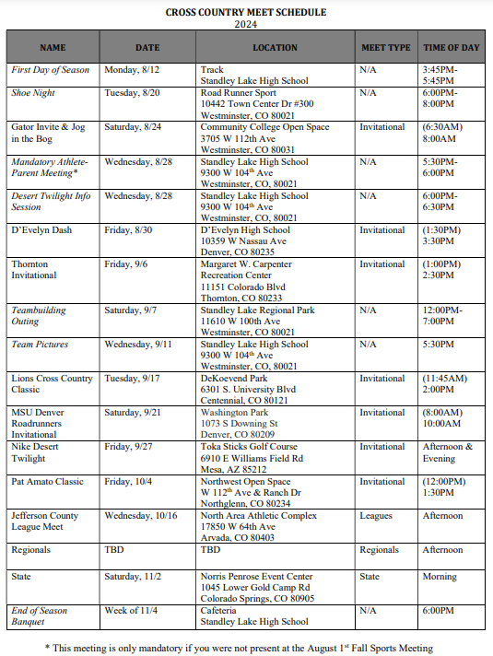
Schedule
Notes:
Schedule is subject to change!! Please visit the website for all schedule updates

Slide 20
Questions?

